Slide 1
ANZ Transactions
Exploratory Data Analysis

Slide 2
About the dataset
The dataset has 12043 transactions.
The dataset describes each of the 12043 transactions with 23 features.
The dataset contains the transactions made by 100 customers in the months of August, September and October.

Slide 3
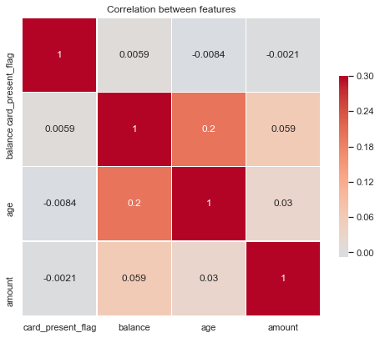
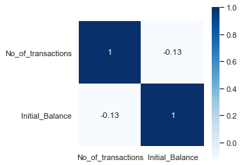
Correlation
There is no correlation between the numerical features.
No Correlation between the initial balance of the customer and the number of transactions made.

Slide 4
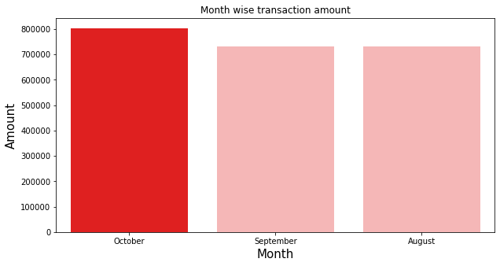
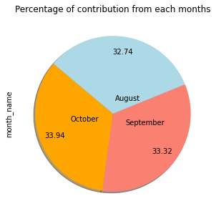
Month Wise Analysis
The number of transactions recorded in all the three months are almost equal.
Highest amount of transaction is recorded in the month of October.

Slide 5
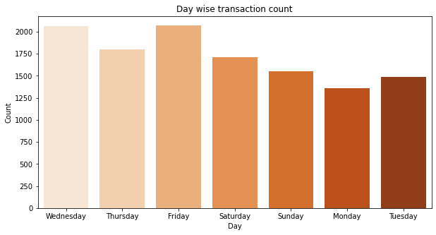
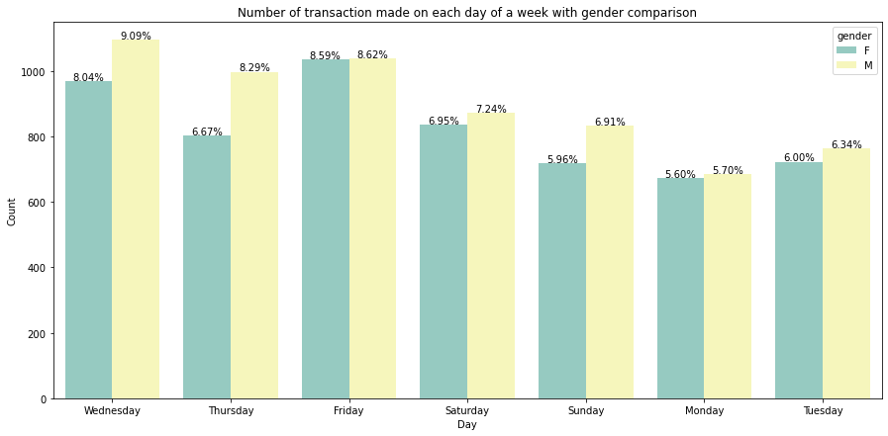
Day Wise Transaction
Wednesday and Friday have the highest number of transactions .
Monday has recorded the lowest number of transactions.
Male Customers have done the higher transactions almost everyday.

Slide 6
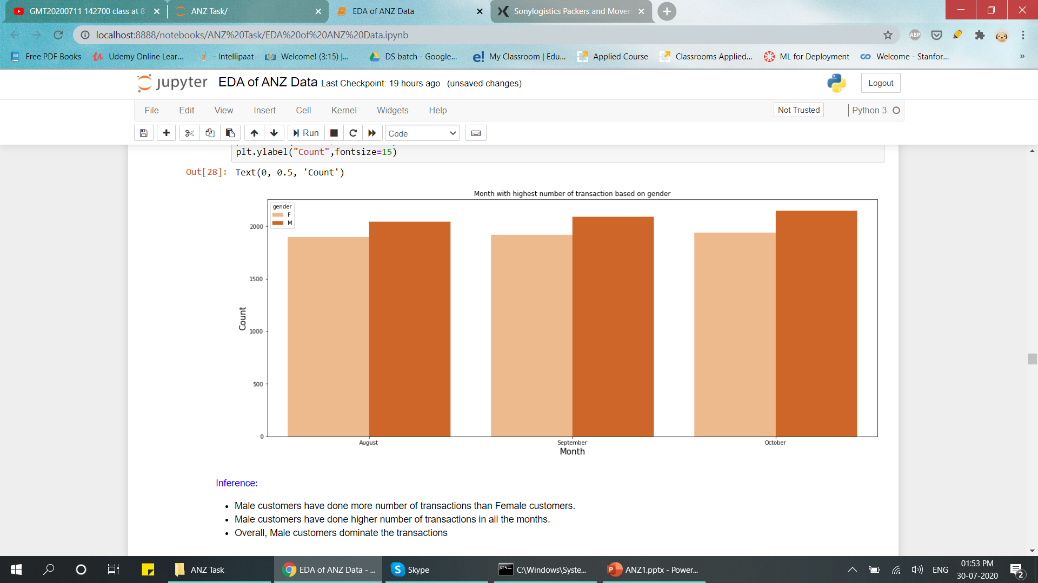
Gender Analysis
Male customers have done more number of transactions than Female customers.
Male customers have done higher number of transactions in all the months.
Overall, Male customers dominate the transactions

Slide 7
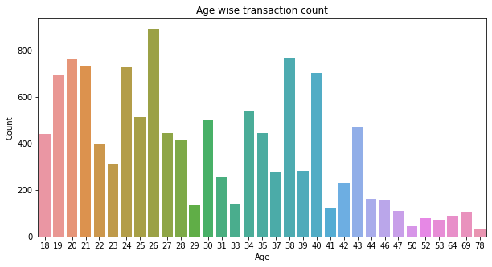
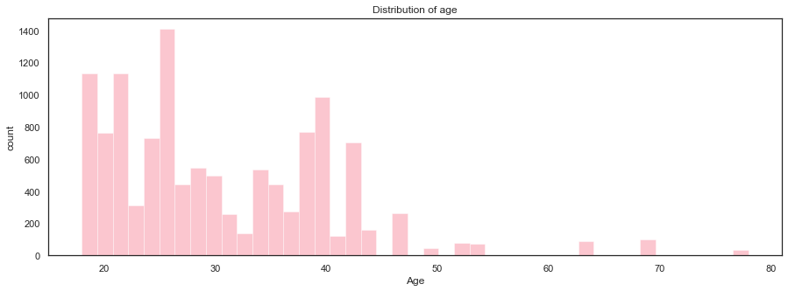
Age Wise Transaction Analysis
Most number of transactions are done by the customers of age group between 20-40.
Highest number of transactions are done by customers of age 26.
Most number of customers belong to age between 20-40.

Slide 8
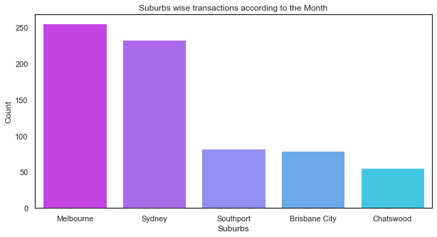
Suburbs wise Transaction Analysis
Melbourne and Sydney have recorded the highest number of transactions.

Slide 9
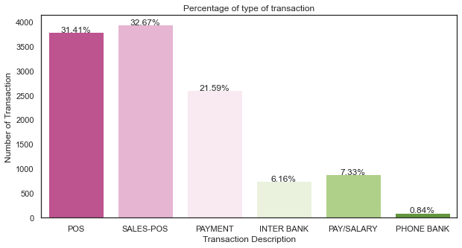
Transaction Analysis
Most of the transactions are done via POS and SALES-POS
Least number of transactions are done via PHONE Bank

Slide 10
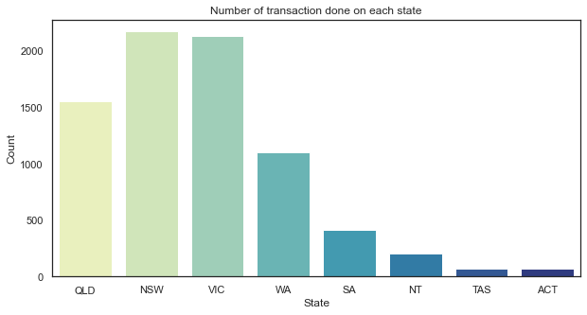
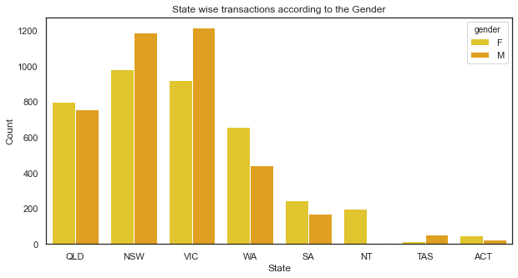
State Wise Transaction Analysis
New South Wales(NSW) has recorded the highest number of transactions
Tasmania(TAS) and Australian Capital Territory(ACT) have the recorded least number of transactions.
Transactions done by male customers are greater in New South Wales(NSW) and Victoria(VIC)

Slide 11
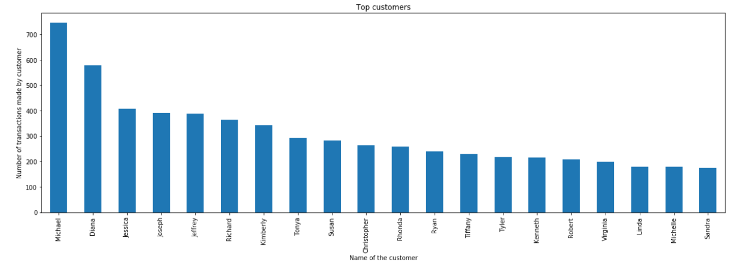
Top Customers

Slide 12
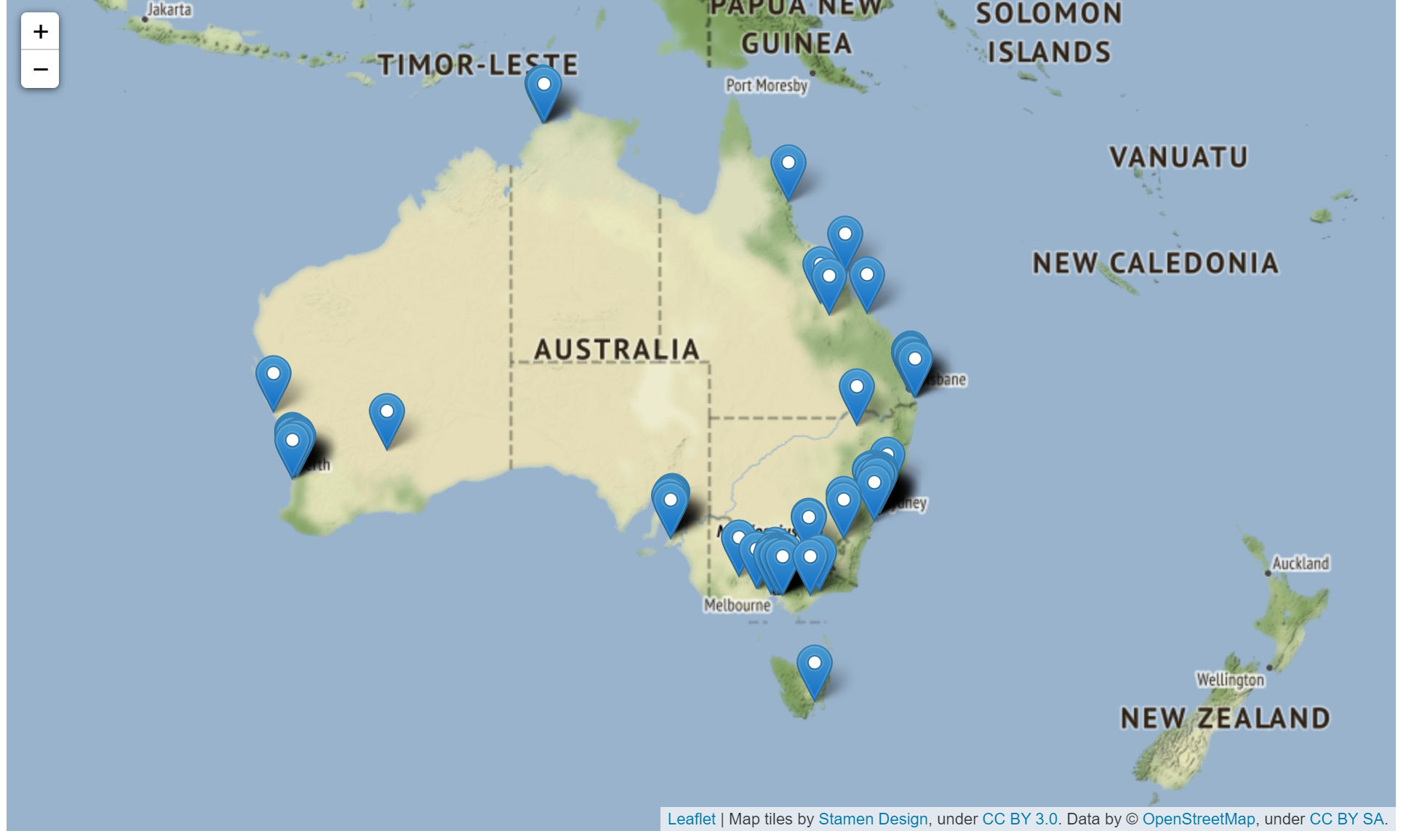
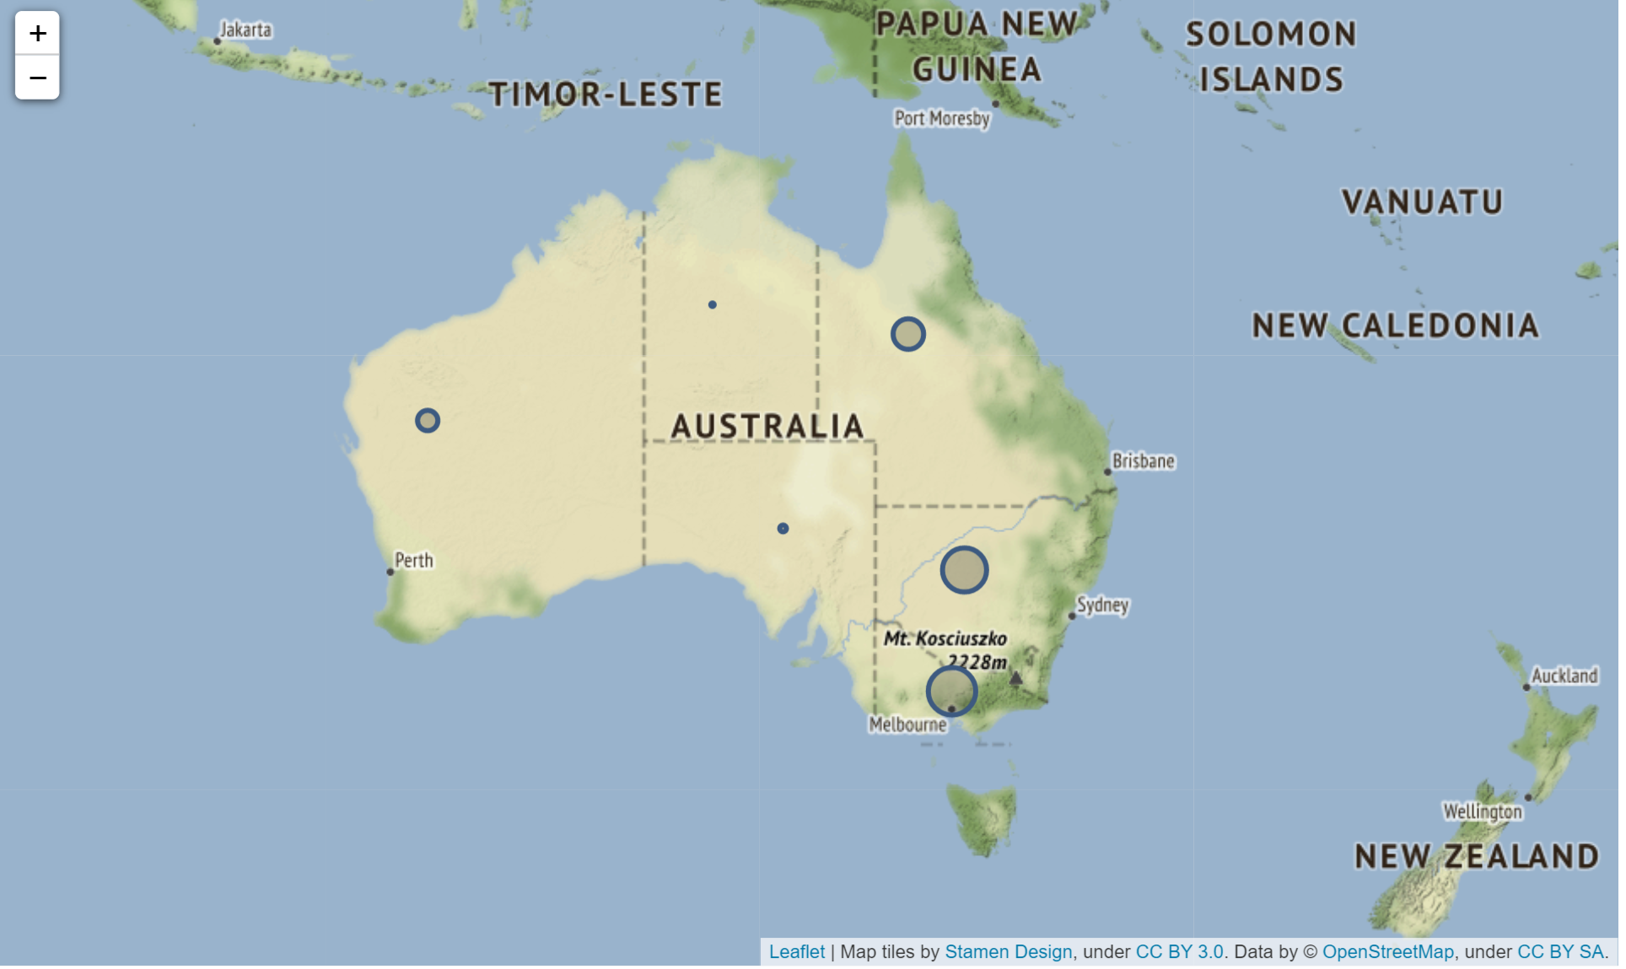
Customer Location Analysis
Most of the customers are located in Melbourne state.
Customers location has been plotted using the latitude and longitude coordinates.

Slide 13
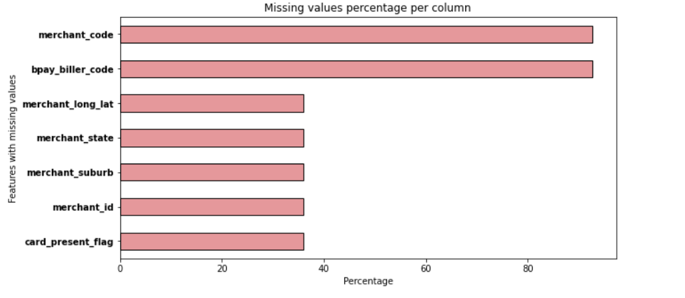
MISC
Features ‘merchant_code’ and ‘bpay_biller_code’ has the highest number of null values.

Slide 14
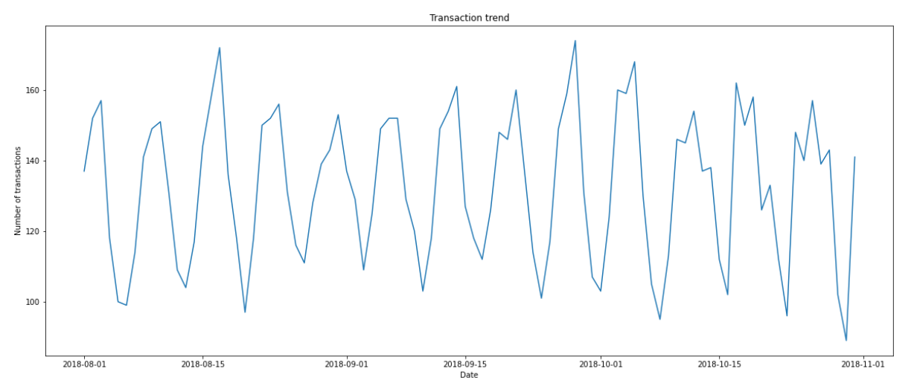
Transaction Trend seems to constant with frequent ups and downs.

